Slide 1
Module 4: Linux Overview
Instructor Materials
CyberOps Associate v1.0
Notes:
Cisco Networking Academy Program
CyberOps Associate v1.0
Module 4: Linux Overview

Slide 2
Instructor Materials – Module 4 Planning Guide
This PowerPoint deck is divided in two parts:
Instructor Planning Guide
Information to help you become familiar with the module
Teaching aids
Instructor Class Presentation
Optional slides that you can use in the classroom
Begins on slide # 10
Note: Remove the Planning Guide from this presentation before sharing with anyone.
For additional help and resources go to the Instructor Home Page and Course Resources for this course. You also can visit the professional development site on www.netacad.com, the official Cisco Networking Academy Facebook page, or Instructor Only FB group.
Notes:
2

Slide 3
What to Expect in this Module
To facilitate learning, the following features within the GUI may be included in this module:
Feature | Description
Hands-On Labs | Labs designed for working with physical equipment.
Videos | Expose learners to new skills and concepts.
Module Quizzes | Self-assessments that integrate concepts and skills learned throughout the series of topics presented in the module.
Module Summary | Briefly recaps module content.

Slide 4
Check Your Understanding
Check Your Understanding activities are designed to let students quickly determine if they understand the content and can proceed, or if they need to review.
Check Your Understanding activities do not affect student grades.
There are no separate slides for these activities in the PPT. They are listed in the notes area of the slide that appears before these activities.
Notes:
4

Slide 5
Module 4: Activities
What activities are associated with this module?
Page # | Activity Type | Activity Name | Optional?
4.2.6 | Lab | Working with Text Files in the CLI | Recommended
4.2.7 | Lab | Getting Familiar with the Linux Shell | Recommended
4.3.4 | Lab | Linux Servers | Recommended
4.4.4 | Lab | Locating Log Files | Recommended
4.5.4 | Lab | Navigating the Linux Filesystem and Permission Settings | Recommended
4.7.7 | Video | Applications, Rootkits, and Piping Commands | Recommended
Notes:
5

Slide 6
Module 4: Best Practices
Prior to teaching Module 4, the instructor should:
Review the activities and assessments for this module.
Try to include as many questions as possible to keep students engaged during classroom presentation.
Topic 4.1
Ask the class what do they know about Linux.
Question the participants if they know about some of the reasons to choose Linux over other operating system.
Ask the participants to share their knowledge and experience about any tool used in Linux.
Notes:
6

Slide 7
Module 4: Best Practices (Contd.)
Topic 4.2
Make the class familiar with the Linux shell.
Ask the learners if they know about any of the basic Linux commands and then discuss some of the commands and their functions.
Question the participants about text editors and then explain the Linux text editors.
Topic 4.3
Brief the class about the client-server communications.
Ask the participants to share their understanding about ports and clients.
Notes:
7

Slide 8
Module 4: Best Practices (Contd.)
Topic 4.4
Explain how the configuration files are used to manage services in Linux.
Brief about device hardening and then ask the class if they know about some of the best practices for device hardening.
Throw a general question about the log files and then explain the Linux Log files and their functions.
Topic 4.5
Discuss with the class about the various types of file systems in Linux.
Ask them what do they know about file permissions in general and then explain the file permissions in Linux.
Tell the class about the hard links and symbolic links in Linux.
Notes:
8

Slide 9
Module 4: Best Practices (Contd.)
Topic 4.6
Brief the class about X Window System.
Show an example of the Linux GUI and ask the class about some of its main components.
Topic 4.7
Discuss how applications are installed and run on a Linux host.
Enquire the participants about updates in the system and discuss how regular updates keep the systems away from vulnerabilities.
How can malware pose a threat to the Linux operating system?
Ask the learners if they know about piping commands.
Notes:
9

Slide 10
Module 4: Linux Overview
CyberOps Associate v1.0
Notes:
Cisco Networking Academy Program
CyberOps Associate v1.0
Module 4: Linux Overview
In-Session Activities / Explanations:
Time: 5 mins
Instructor Notes:
Welcome the audience in a warm and cordial manner. Ensure that everyone is set up with the required resources.
Introduce yourself briefly and invite participants to introduce self with name, dept. and role, if deemed all right.
Interact with the audience to give an overview about the Linux operating system and some Linux skills.
Introduce the topic and encourage learners to come up with a list of expectations from the session. Collate topics on the white board or Desktop while using learner’s inputs to interpret them in words.
Read out the Objectives and briefly describe each.
Key Points: NA

Slide 11
Module Objectives
Module Title: Linux Overview
Module Objective: Implement basic Linux security.
Topic Title | Topic Objective
Linux Basics | Explain why Linux skills are essential for network security monitoring and investigation.
Working in the Linux Shell | Use the Linux shell to manipulate text files.
Linux Servers and Clients | Explain how client-server networks function.
Basic Server Administration | Explain how a Linux administrator locates and manipulates security log files.
The Linux File System | Manage the Linux file system and permissions.
Working in the Linux GUI | Explain the basic components of the Linux GUI.
Working on a Linux Host | Use tools to detect malware on a Linux host.
Notes:
11
CyberOps Associate v1.0
4 – Linux Overview
4.0 – Introduction
4.0.2 – What Will I Learn in this Module?

Slide 12
4.1 Linux Basics
Notes:
Source:
4 – Linux Overview
4.1 – Linux Basics
In-Session Activities / Explanations:
Time: 5 mins
Instructor Notes:
Introduce the topic and discuss about Linux and its history.
Explain the learners about the reasons why Linux becomes the operating system of choice.
Ensure the learners have knowledge about the importance of Linux in Security Operations Center (SOC).
By the end of the topic, discuss about the tools used in Linux.
Key Points: Linux, SOC, PenTesting, Kali

Slide 13

Linux Overview What is Linux?
Linux is an operating system that was created in 1991.
Linux is open source, fast, reliable, and small. It requires very little hardware resources to run and is highly customizable.
Linux is part of several platforms and can be found on devices anywhere from wristwatches to supercomputers.
Linux is designed to be connected to the network, which makes it much simpler to write and use network-based applications.
A Linux distribution is the term used to describe packages created by different organizations and include the Linux kernel with customized tools and software packages.
Notes:
4 – Linux Overview
4.1 – Linux Basics
4.1.1 – What is Linux?

Slide 14
Linux Overview The Value of Linux
Linux is often the operating system of choice in the Security Operations Center (SOC). These are some of the reasons to choose Linux:
Linux is open source - Any person can acquire Linux at no charge and modify it to fit specific needs.
The Linux CLI is very powerful - The Linux Command Line Interface (CLI) is extremely powerful and enables analysts to perform tasks not only directly on a terminal, but also remotely.
The user has more control over the OS - The administrator user in Linux, known as the root user, or superuser, can modify any aspect of the computer with a few keystrokes.
It allows for better network communication control - Control is an inherent part of Linux.
Notes:
4 – Linux Overview
4.1 – Linux Basics
4.1.2 – The Value of Linux

Slide 15
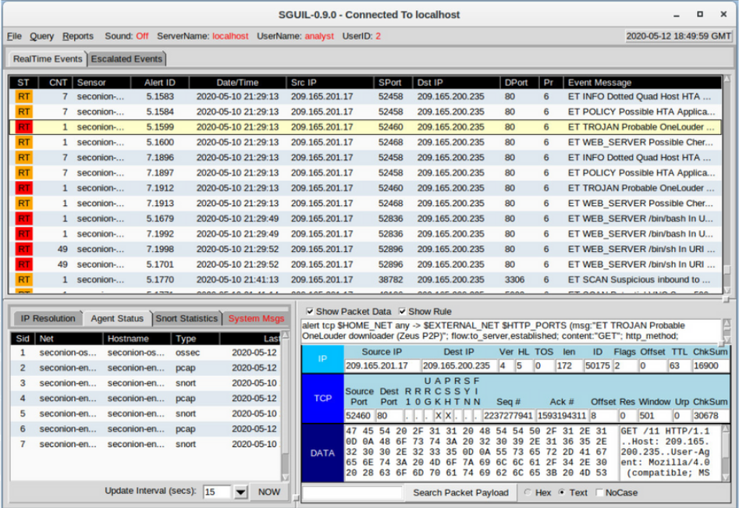
Linux Overview Linux in the SOC
The flexibility provided by Linux is a great feature for the SOC. The entire operating system can be tailored to become the perfect security analysis platform.
Sguil is the cybersecurity analyst console in a special version of Linux called Security Onion.
Security Onion is an open source suite of tools that work together for network security analysis.
Notes:
4 – Linux Overview
4.1 – Linux Basics
4.1.3 – Linux in the SOC

Slide 16
Linux Overview Linux in the SOC (Contd.)
The following table lists a few tools that are often found in a SOC:
SOC Tool | Description
Network packet capture software | A crucial tool for a SOC analyst as it makes it possible to observe and understand every detail of a network transaction. Wireshark is a popular packet capture tool.
Malware analysis tools | These tools allow analysts to safely run and observe malware execution without the risk of compromising the underlying system.
Intrusion detection systems (IDSs) | These tools are used for real-time traffic monitoring and inspection. If any aspect of the currently flowing traffic matches any of the established rules, a pre-defined action is taken.
Notes:
4 – Linux Overview
4.1 – Linux Basics
4.1.3 – Linux in the SOC

Slide 17
Linux Overview Linux in the SOC (Contd.)
SOC Tool | Description
Firewalls | This software is used to specify, based on pre-defined rules, whether traffic is allowed to enter or leave a network or device.
Log managers | Log files are used to record events. Because a network can generate a very large number of log entries, log manager software is employed to facilitate log monitoring.
Security information and event management (SIEM) | SIEMs provide real-time analysis of alerts and log entries generated by network appliances such as IDSs and firewalls.
Ticketing systems | Task ticket assignment, editing, and recording is done through a ticket management system. Security alerts are often assigned to analysts through a ticketing system.
Notes:
4 – Linux Overview
4.1 – Linux Basics
4.1.3 – Linux in the SOC

Slide 18
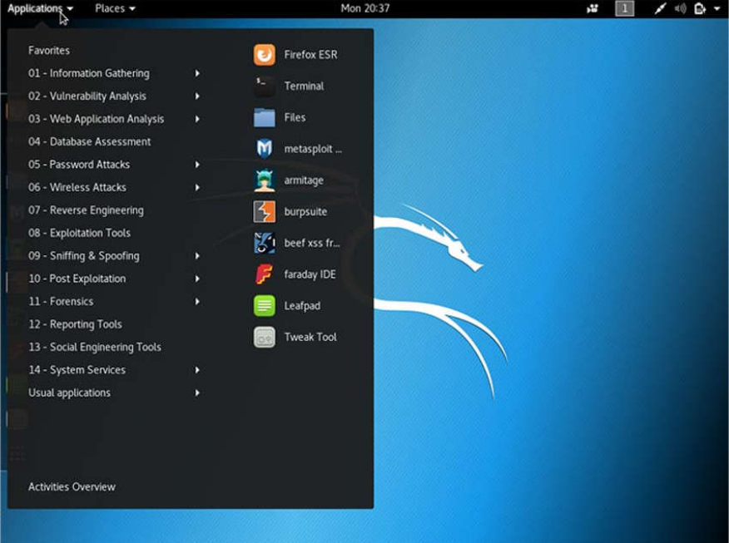
Linux Overview Linux Tools
Linux computers that are used in the SOC often contain penetration testing tools.
A penetration test, also known as PenTesting, is the process of looking for vulnerabilities in a network or computer by attacking it.
Packet generators, port scanners, and proof-of-concept exploits are examples of PenTesting tools.
Kali Linux is a Linux distribution which contains many penetration tools together in a single Linux distribution.
Notice all the major categories of penetration testing tools of Kali Linux.
Notes:
4 – Linux Overview
4.1 – Linux Basics
4.1.4 – Linux Tools

Slide 19
4.2 Working in the Linux Shell
Notes:
Source:
4 – Linux Overview
4.2 – Working in the Linux Shell
In-Session Activities / Explanations:
Time: 15 mins
Instructor Notes:
Give a brief introduction about the topic and help the learners getting familiar with Linux Shell.
Ensure the learners have understanding about the Linux commands and their functions.
Discuss about different types of Linux text editors and their importance with examples.
Key Points: Linux Shell, CLI, Text files.

Slide 20
Working in the Linux Shell The Linux Shell
In Linux, the user communicates with the OS by using the CLI or the GUI.
Linux often starts in the GUI by default. This hides the CLI from the user.
One way to access the CLI from the GUI is through a terminal emulator application. These applications provide user access to the CLI and are named as some variation of the word terminal.
In Linux, popular terminal emulators are Terminator, eterm, xterm, konsole, and gnome-terminal.
Fabrice Bellard has created JSLinux which allows an emulated version of Linux to run in a browser.
Note: The terms shell, console, console window, CLI terminal, and terminal window are often used interchangeably.
Notes:
4 – Linux Overview
4.2 – Working in the Linux Shell
4.2.1 – The Linux Shell

Slide 21
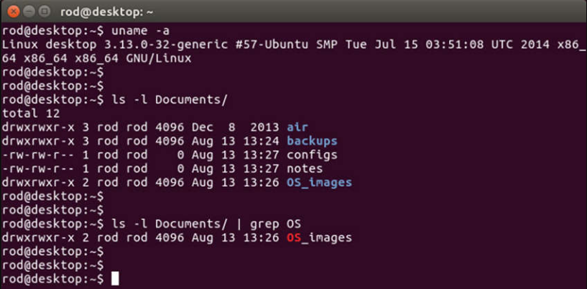
Working in the Linux Shell The Linux Shell (Contd.)
The figure shows gnome-terminal, a popular Linux terminal emulator.
Notes:
4 – Linux Overview
4.2 – Working in the Linux Shell
4.2.1 – The Linux Shell

Slide 22
Working in the Linux Shell Basic Commands
Linux commands are programs created to perform a specific task.
As the commands are programs stored on the disk, when a user types a command, the shell must find it on the disk before it can be executed.
The following table lists basic Linux commands and their functions:
Command | Description
mv | Moves or renames files and directories.
chmod | Modifies file permissions.
chown | Changes the ownership of a file.
dd | Copies data from an input to an output.
pwd | Displays the name of the current directory.
ps | Lists the processes that are currently running in the system.
su | Simulates a login as another user or to become a superuser.
Notes:
4 – Linux Overview
4.2 – Working in the Linux Shell
4.2.2 – Basic Commands

Slide 23
Working in the Linux Shell Basic Commands (Contd.)
Command | Description
sudo | Runs a command as a super user, by default, or another named user.
grep | Used to search for specific strings of characters within a file or other command outputs.
ifconfig | Used to display or configure network card related information.
apt-get | Used to install, configure and remove packages on Debian and its derivatives.
iwconfig | Used to display or configure wireless network card related information.
shutdown | Shuts down the system and performs shut down related tasks including restart, halt, put to sleep or kick out all currently connected users.
passwd | Used to change the password.
cat | Used to list the contents of a file and expects the file name as the parameter.
man | Used to display the documentation for a specific command.
Notes:
4 – Linux Overview
4.2 – Working in the Linux Shell
4.2.2 – Basic Commands

Slide 24
Working in the Linux Shell File and Directory Commands
Many command line tools are included in Linux by default. The following table lists a few of the most common commands related to files and directories:
Command | Description
Is | Displays the files inside a directory.
cd | Changes the current directory.
mkdir | Creates a directory under the current directory.
cp | Copies files from source to destination.
mv | Moves files to a different directory.
rm | Removes files.
grep | Searches for specific strings of characters within a file or other commands outputs.
cat | Lists the contents of a file and expects the file name as the parameter.
Notes:
4 – Linux Overview
4.2 – Working in the Linux Shell
4.2.3 – File and Directory Commands

Slide 25
Working in the Linux Shell Working with Text Files
Linux has many different text editors, with various features and functions.
Some text editors include graphical interfaces while others are command-line only tools. Each text editor includes a feature set designed to support a specific type of task.
Some text editors focus on the programmer and include features such as syntax highlighting, parenthesis check, and other programming-focused features.
While graphical text editors are convenient and easy to use, command line-based text editors are very important for Linux users. The main benefit of command-line-based text editors is that they allow for text file editing from a remote computer.
Notes:
4 – Linux Overview
4.2 – Working in the Linux Shell
4.2.4 – Working with Text Files

Slide 26
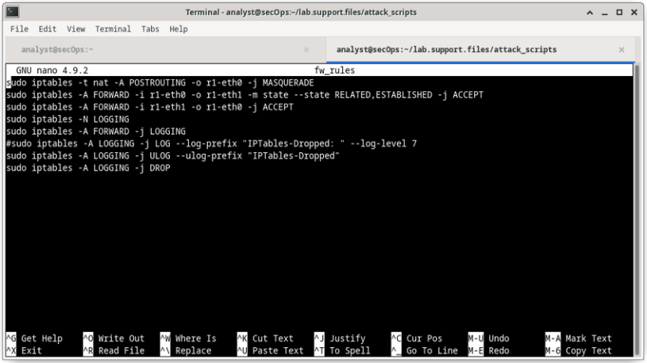
Working in the Linux Shell Working with Text Files (Contd.)
The figure shows nano, a popular command-line text editor.
The administrator is editing firewall rules. Text editors are often used for system configuration and maintenance in Linux.
Due to the lack of graphical support, nano (or GNU nano) can only be controlled with the keyboard.
Notes:
4 – Linux Overview
4.2 – Working in the Linux Shell
4.2.4 – Working with Text Files

Slide 27
Working in the Linux Shell The Importance of Text Files in Linux
In Linux, everything is treated as a file. This includes the memory, the disks, the monitor, and the directories.
Configuration files are text files which are used to store adjustments and settings for specific applications or services.
Users with proper permission levels can use text editors to change the contents of configuration files.
After the changes are made, the file is saved and can be used by the related service or application. Users are able to specify exactly how they want any given application or service to behave. When launched, services and applications check the contents of specific configuration files to adjust their behavior accordingly.
Note: The administrator used the command sudo nano /etc/hosts to open the file. The command sudo (short for “superuser do”) invokes the superuser privilege to use the nano text editor to open the host file.
Notes:
4 – Linux Overview
4.2 – Working in the Linux Shell
4.2.5 – The Importance of Text Files in Linux

Slide 28
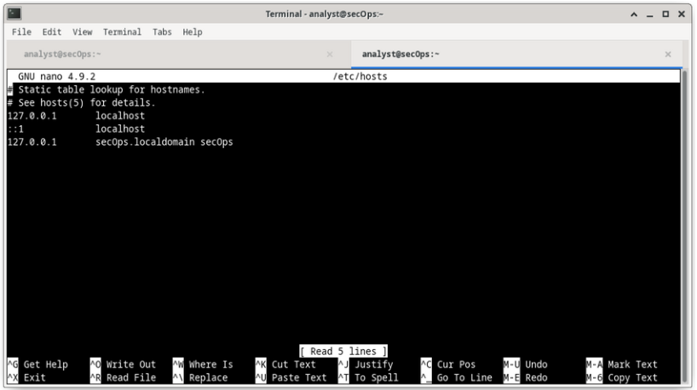
Working in the Linux Shell The Importance of Text Files in Linux (Contd.)
In the figure, the administrator opened the host configuration file in nano for editing.
The host file contains static mappings of host IP addresses to names.
The names serve as shortcuts that allow connecting to other devices by using a name instead of an IP address. Only the superuser can change the host file.
Notes:
4 – Linux Overview
4.2 – Working in the Linux Shell
4.2.5 – The Importance of Text Files in Linux

Slide 29
Working in the Linux Shell
Lab – Working with Text Files in the CLI
In this lab, you will get familiar with Linux command-line text editors and configuration files.
Notes:
4 – Linux Overview
4.2 – Working in the Linux Shell
4.2.6 – Lab - Working with Text Files in the CLI

Slide 30
Working in the Linux Shell Lab – Getting Familiar with the Linux Shell
In this lab, you will use the Linux command line to manage files and folders and perform some basic administrative tasks.
Notes:
4 – Linux Overview
4.2 – Working in the Linux Shell
4.2.7 – Lab – Getting Familiar with the Linux Shell

Slide 31
4.3 Linux Servers and Clients
Notes:
Source:
4 – Linux Overview
4.3 – Linux Servers and Clients
In-Session Activities / Explanations:
Time: 10 mins
Instructor Notes:
Ensure the learners have a knowledge about the client-server communications.
Explain the learners about ports, servers and clients.
Key Points: Client-Server Communications, Services, Ports

Slide 32
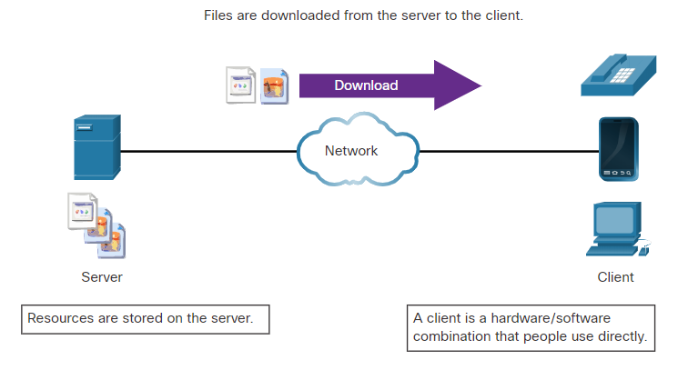
Linux Servers and Clients An Introduction to Client-Server Communications
Servers are computers with software installed that enables them to provide services to clients across the network.
Some provide external resources such as files, email messages, or web pages to clients upon request.
Other services run maintenance tasks such as log management, disk scanning and so on.
Each service requires separate server software.
The server in the figure uses file server software to provide clients with the ability to retrieve and submit files.
Notes:
4 – Linux Overview
4.3 – Linux Servers and Clients
4.3.1 – An Introduction to Client-Server Communications

Slide 33
Linux Servers and Clients Servers, Services, and Their Ports
A port is a reserved network resource used by a service.
While the administrator can decide which port to use with any given service, many clients are configured to use a specific port by default.
The following table lists a few commonly used ports and their services. These are also called as well-known ports.
Port | Description
20/21 | File Transfer Protocol (FTP)
22 | Secure Shell (SSH)
23 | Telnet remote login service
25 | Simple Mail Transfer Protocol (SMTP)
53 | Domain Name System (DNS)
67/68 | Dynamic Host Configuration Protocol (DHCP)
Notes:
4 – Linux Overview
4.3 – Linux Servers and Clients
4.3.2 – Servers, Services, and Their Ports

Slide 34
Linux Servers and Clients Servers, Services, and Their Ports (Contd.)
Port | Description
69 | Trivial File Transfer Protocol (TFTP)
80 | Hypertext Transfer Protocol (HTTP)
110 | Post Office Protocol version 3 (POP3)
123 | Network Time Protocol (NTP)
143 | Internet Message Access Protocol (IMAP)
161/162 | Simple Network Management Protocol (SNMP)
443 | HTTP Secure (HTTPS)
Notes:
4 – Linux Overview
4.3 – Linux Servers and Clients
4.3.2 – Servers, Services, and Their Ports

Slide 35
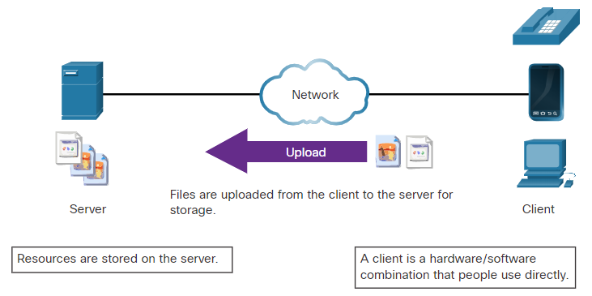
Linux Servers and Clients Clients
Clients are programs or applications designed to communicate with a specific type of server.
Clients use a well-defined protocol to communicate with the server.
Web browsers are web clients that are used to communicate with web servers through the Hyper Text Transfer Protocol on port 80.
The File Transfer Protocol client is software used to communicate with an FTP server.
The figure shows a client uploading files to a server.
Notes:
4 – Linux Overview
4.3 – Linux Servers and Clients
4.3.3 – Clients

Slide 36
Linux Servers and Clients Lab - Linux Servers
In this lab, you will use the Linux command line to identify servers that are running on a computer.
Notes:
4 – Linux Overview
4.3 – Linux Servers and Clients
4.3.4 – Lab - Linux Servers

Slide 37
4.4 Basic Server Administration
Notes:
Source:
4 – Linux Overview
4.4 – Basic Server Administration
In-Session Activities / Explanations:
Time: 15 mins
Instructor Notes:
This topic familiarizes the learner with basic server administration.
Ensure the learners have a understanding about how the services are managed in Linux.
Discuss about device hardening and its best practices.
By the end of the topic, explain the various Linux Log files and their functions.
Key Points: Nginx, Device Hardening, Log files

Slide 38
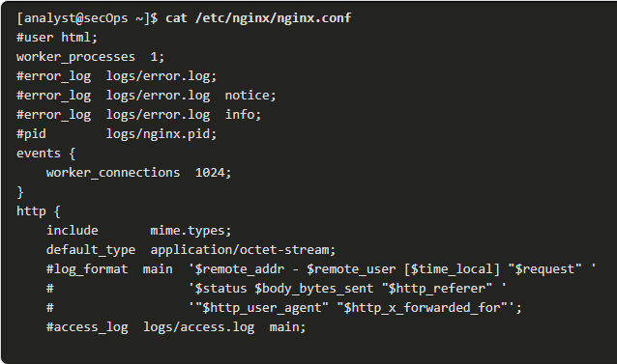
Basic Server Administration Service Configuration Files
In Linux, services are managed using configuration files.
Common options in configuration files are port number, location of the hosted resources, and client authorization details.
When the service starts, it looks for its configuration files, loads them into memory, and adjusts itself according to the settings in the files.
The command output shows a portion of the configuration file for Nginx, which is a lightweight web server for Linux.
Notes:
4 – Linux Overview
4.4 – Basic Server Administration
4.4.1 – Service Configuration Files

Slide 39
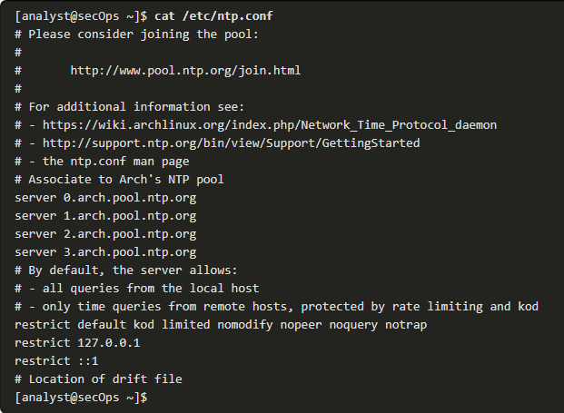
Basic Server Administration Service Configuration Files (Contd.)
The command output shows the configuration file for the network time protocol (NTP).
Notes:
4 – Linux Overview
4.4 – Basic Server Administration
4.4.1 – Service Configuration Files

Slide 40
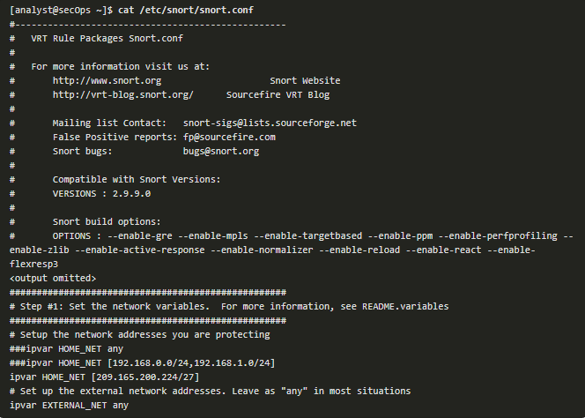
Basic Server Administration Service Configuration Files (Contd.)
The command output shows the configuration file for Snort, a Linux-based intrusion detection system (IDS).
There is no rule for a configuration file format. It is the choice of the service’s developer. However, the option = value format is often used.
Notes:
4 – Linux Overview
4.4 – Basic Server Administration
4.4.1 – Service Configuration Files

Slide 41
Basic Server Administration Hardening Devices
Device hardening involves implementing proven methods of securing the device and protecting its administrative access.
Some of these methods involve maintaining passwords, configuring enhanced remote login features, and implementing secure login with SSH.
Depending on the Linux distribution, many services are enabled by default. Stopping such services and ensuring they do not automatically start at boot time is another device hardening technique.
OS updates are extremely important to maintaining a hardened device. OS developers create and issue fixes and patches regularly.
Notes:
4 – Linux Overview
4.4 – Basic Server Administration
4.4.2 – Hardening Devices

Slide 42
Basic Server Administration Hardening Devices (Contd.)
The following are basic best practices for device hardening:
Ensure physical security
Minimize installed packages
Disable unused services
Use SSH and disable the root account login over SSH
Keep the system updated
Disable USB auto-detection
Enforce strong passwords
Force periodic password changes
Keep users from re-using old passwords
Notes:
4 – Linux Overview
4.4 – Basic Server Administration
4.4.2 – Hardening Devices

Slide 43
Basic Server Administration Monitoring Service Logs
Log files are the records that a computer stores to keep track of important events. Kernel, services, and application events are all recorded in log files.
By monitoring Linux log files, an administrator gains a clear picture of the computer’s performance, security status, and any underlying issues.
In Linux, log files can be categorized as:
Application logs
Event logs
Service logs
System logs
Some logs contain information about daemons that are running in Linux. A daemon is a background process that runs without the need for user interaction.
Notes:
4 – Linux Overview
4.4 – Basic Server Administration
4.4.3 – Monitoring Service Logs

Slide 44
Basic Server Administration Monitoring Service Logs (Contd.)
The following table lists a few popular Linux log files and their functions:
Linux Log File | Description
/var/log/messages | This directory contains generic computer activity logs. It is mainly used to store informational and non-critical system messages.
/var/log/auth.log | This file stores all authentication-related events in Debian and Ubuntu computers. Anything involving the user authorization mechanism can be found in this file.
/var/log/secure | This directory is used by RedHat and CentOS computers. It also tracks sudo logins, SSH logins, and other errors logged by SSSD.
/var/log/boot.log | This file stores boot-related information and messages logged during the computer startup process.
Notes:
4 – Linux Overview
4.4 – Basic Server Administration
4.4.3 – Monitoring Service Logs

Slide 45
Basic Server Administration Monitoring Service Logs (Contd.)
Linux Log File | Description
/var/log/dmesg | This directory contains kernel ring buffer messages. Information related to hardware devices and their drivers is recorded here. It is very important because, due to their low-level nature, logging systems such as syslog are not running when these events take place and are unavailable to the administrator in real-time.
/var/log/kern.log | This file contains information logged by the kernel.
/var/log/cron | Cron is a service used to schedule automated tasks in Linux and this directory stores its events. Whenever a scheduled task (or cron job) runs, all its relevant information including execution status and error messages are stored here.
/var/log/mysqld.log or /var/log/mysql.log | This is the MySQL log file. All debug, failure and success messages related to the mysqld process and mysqld_safe daemon are logged here.
Notes:
4 – Linux Overview
4.4 – Basic Server Administration
4.4.3 – Monitoring Service Logs

Slide 46
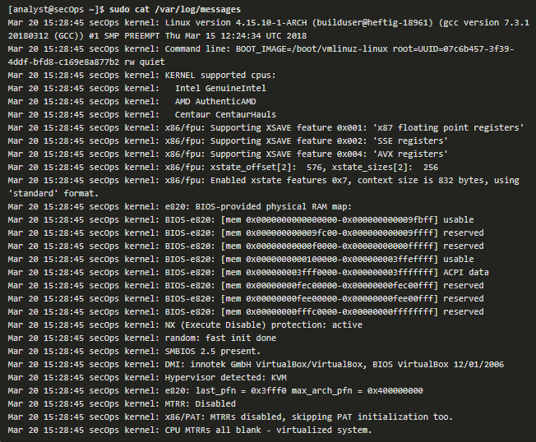
Basic Server Administration Monitoring Service Logs (Contd.)
The command output shows a portion of /var/log/messages log file.
Each line represents a logged event.
The timestamps at the beginning of the lines mark the moment the event took place.
Notes:
4 – Linux Overview
4.4 – Basic Server Administration
4.4.3 – Monitoring Service Logs

Slide 47
Basic Server Administration Lab – Locating Log Files
In this lab, you will get familiar with locating and manipulating Linux log files.
Notes:
4 – Linux Overview
4.4 – Basic Server Administration
4.4.4 – Lab – Locating Log Files

Slide 48
4.5 The Linux File System
Notes:
Source:
4 – Linux Overview
4.5 – The Linux File System
In-Session Activities / Explanations:
Time: 20 mins
Instructor Notes:
Introduce the topic and discuss about the various types of file systems in Linux.
Take the learners through the file permissions in Linux.
Talk over the hard links and symbolic links and the commands used to create them.
Key Points: File systems, File permissions, Hard links, Symbolic links

Slide 49
The Linux File System The File System Types in Linux
There are many different kinds of file systems, varying in properties of speed, flexibility, security, size, structure, logic and more.
The administrator decides the file system type which is suitable for the operating system.
The following table lists a few file system types commonly found and supported by Linux.
Linux File System | Description
ext2 (second extended file system) | ext2 was the default file system in several major Linux distributions until supplanted by ext3. ext2 is still the file system of choice for flash-based storage media, as its lack of a journal, increases performance and minimizes the number of writes. As flash memory devices have a limited number of write operations, minimizing write operations increases the device’s lifetime.
Notes:
4 – Linux Overview
4.5 – The Linux File System
4.5.1 – The File System Types in Linux

Slide 50
The Linux File System The File System Types in Linux (Contd.)
Linux File System | Description
ext3 (third extended file system) | ext3 is a journaled file system designed to improve the existing ext2 file system. A journal or log, the main feature added to ext3, is a technique used to minimize the risk of file system corruption in the event of sudden power loss. The file systems keeps a log of all the changes to be made. If the computer crashes before the change is complete, the journal can be used to restore or correct any issues created by the crash. The maximum file size in ext3 file systems is 32 TB.
ext4 (fourth extended file system) | ext4 was created based on a series of extensions to ext3. While the extensions improve the performance of ext3 and increase supported file sizes, developers were concerned about stability issues and were opposed to adding the extensions to the stable ext3. The ext3 project was split in two; one kept as ext3 and its normal development and the other, named ext4, incorporated the mentioned extensions.
Notes:
4 – Linux Overview
4.5 – The Linux File System
4.5.1 – The File System Types in Linux

Slide 51
The Linux File System The File System Types in Linux (Contd.)
Linux File System | Description
NFS (Network File System) | NFS is a network-based file system, allowing file access over the network. From the user standpoint, there is no difference between accessing a file stored locally or on another computer on the network. NFS is an open standard which allows anyone to implement it.
CDFS (Compact Disc File System) | CDFS was created specifically for optical disk media.
Swap File System | The swap file system is used by Linux when it runs out of RAM. When this happens, the kernel moves inactive RAM content to the swap partition on the disk. While swap partitions can be useful to Linux computers with a limited amount of memory, they should not be considered as a primary solution. Swap partition is stored on disk which has much lower access speeds than RAM.
Notes:
4 – Linux Overview
4.5 – The Linux File System
4.5.1 – The File System Types in Linux

Slide 52
The Linux File System The File System Types in Linux (Contd.)
Linux File System | Description
HFS Plus or HFS+ (Hierarchical File System Plus) | A file system used by Apple in its Macintosh computers. The Linux kernel includes a module for mounting HFS+ for read-write operations.
APFS (Apple File System) | An updated file system that is used by Apple devices. It provides strong encryption and is optimized for flash and solid-state drives.
Master Boot Record (MBR) | Located in the first sector of a partitioned computer, the MBR stores all the information about the way in which the file system is organized. The MBR quickly hands over control to a loading function, which loads the OS.
Notes:
4 – Linux Overview
4.5 – The Linux File System
4.5.1 – The File System Types in Linux

Slide 53
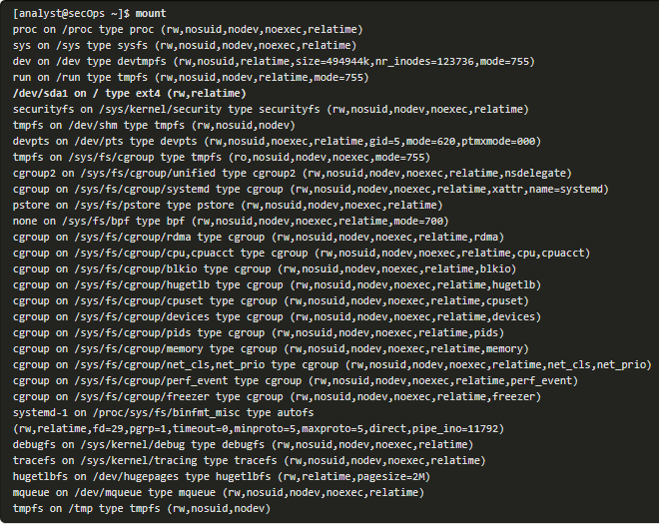
The Linux File System The File System Types in Linux (Contd.)
Mounting is the term used for the process of assigning a directory to a partition.
After a successful mount operation, the file system contained on the partition is accessible through the specified directory.
The command output shows the output of the mount command issued in the Cisco CyberOPS VM.
Notes:
4 – Linux Overview
4.5 – The Linux File System
4.5.1 – The File System Types in Linux

Slide 54
The Linux File System Linux Roles and File Permissions
Linux uses file permissions in order to organize the system and enforce boundaries within the computer.
Every file in Linux carries its file permissions, which define the actions that the owner, the group, and others can perform with the file.
The possible permission rights are Read, Write, and Execute.
The ls command with the -l parameter lists additional information about the file.
Notes:
4 – Linux Overview
4.5 – The Linux File System
4.5.2 – Linux Roles and File Permissions

Slide 55
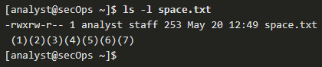
The Linux File System Linux Roles and File Permissions (Contd.)
The output of the ls -l command provides a lot of information about the file space.txt:
The first field displays the permissions with space.txt (-rwxrw-r--).
The second field defines the number of hard links to the file (number 1 after the permissions).
The third and fourth field display the user (analyst) and group (staff) who own the file, respectively.
The fifth field displays the file size in bytes. The space.txt file has 253 bytes.
The sixth field displays the date and time of the last modification.
The seventh field displays the file name.
Notes:
4 – Linux Overview
4.5 – The Linux File System
4.5.2 – Linux Roles and File Permissions

Slide 56
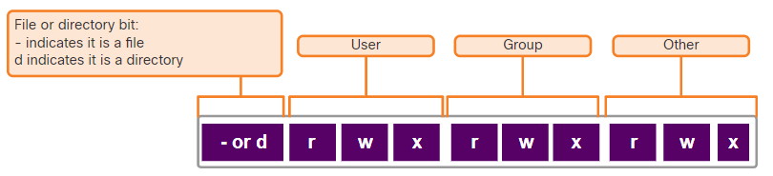
The Linux File System Linux Roles and File Permissions (Contd.)
The figure here shows a breakdown of file permissions in Linux. The file space.txt has the following permissions:
The dash (-) means that this is a file.
The first set of characters (rwx) is for user permission. The user (analyst) who owns the file can Read, Write and eXecute the file.
The second set of characters is for group permissions (rw-). The group (staff) who owns the file can Read and Write to the file.
The third set of characters is for any other user or group permissions (r--) who can only Read the file.
Notes:
4 – Linux Overview
4.5 – The Linux File System
4.5.2 – Linux Roles and File Permissions

Slide 57
The Linux File System Linux Roles and File Permissions (Contd.)
Octal values are used to define permissions.
File permissions are a fundamental part of Linux and cannot be broken.
The only user that can override file permission on a Linux computer is the root user.
Binary | Octal | Permission | Description
000 | 0 | --- | No access
001 | 1 | --x | Execute only
010 | 2 | -w- | Write only
011 | 3 | -wx | Write and Execute
100 | 4 | r-- | Read only
101 | 5 | r-x | Read and Execute
110 | 6 | rw- | Read and Write
111 | 7 | rwx | Read, Write and Execute
Notes:
4 – Linux Overview
4.5 – The Linux File System
4.5.2 – Linux Roles and File Permissions

Slide 58
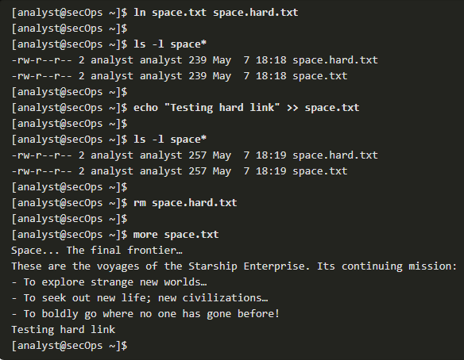
The Linux File System Hard Links and Symbolic Links
A hard link is another file that points to the same location as the original file.
Use the command ln to create a hard link.
The first argument is the existing file and the second argument is the new file.
As shown in the command output, the file space.txt is linked to space.hard.txt and the link field now shows 2.
Both files point to the same location in the file system. If you change one file, the other is changed, as well.
The echo command is used to add some text to space.txt.
Notes:
4 – Linux Overview
4.5 – The Linux File System
4.5.3 – Hard Links and Symbolic Links

Slide 59
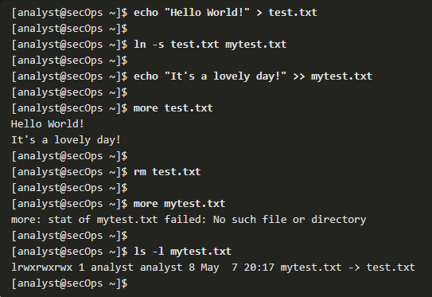
The Linux File System Hard Links and Symbolic Links (Contd.)
A symbolic link, also called a symlink or soft link, is similar to a hard link in that applying changes to the symbolic link will also change the original file.
As shown in the command output, use the ln command option -s to create a symbolic link.
Notice that adding a line of text to test.txt also adds the line to mytest.txt.
Notes:
4 – Linux Overview
4.5 – The Linux File System
4.5.3 – Hard Links and Symbolic Links

Slide 60
The Linux File System Hard Links and Symbolic Links (Contd.)
The following table shows several benefits of symbolic links over hard links:
Hard Links | Soft Links
Locating hard links is difficult. | Symbolic links show the location of the original file in the ls -l command.
Hard links are limited to the file system in which they are created. | Symbolic links can link to a file in another file system.
Hard links cannot link to a directory as the system itself uses hard links to define the hierarchy of the directory structure. | Symbolic links can link to directories.
Notes:
4 – Linux Overview
4.5 – The Linux File System
4.5.3 – Hard Links and Symbolic Links

Slide 61
The Linux File System Lab - Navigating the Linux Filesystem and Permission Settings
In this lab, you will familiarize yourself with Linux filesystems.
Notes:
4 – Linux Overview
4.5 – The Linux File System
4.5.4 – Lab - Navigating the Linux Filesystem and Permission Settings

Slide 62
4.6 Working with the Linux GUI
Notes:
Source:
4 – Linux Overview
4.6 – Working with the Linux GUI
In-Session Activities / Explanations:
Time: 10 mins
Instructor Notes:
Introduce the topic and talk about the X Window System.
Ensure that the learners have knowledge about the Linux GUI.
Key Points: X Windows System, Linux GUI

Slide 63
Working with the Linux GUI X Window System
The graphical interface present in most Linux computers is based on the X Window System.
X Window, also known as X or X11, is a windowing system designed to provide the basic framework for a GUI.
X includes functions for drawing and moving windows on the display device and interacting with a mouse and keyboard.
X works as a server, which allows a remote user to use the network to connect, start a graphical application, and have the graphical window open on the remote terminal.
X does not specify the user interface, leaving it to other programs, such as window managers, to define all the graphical components.
Notes:
4 – Linux Overview
4.6 – Working with the Linux GUI
4.6.1 – X Window System

Slide 64
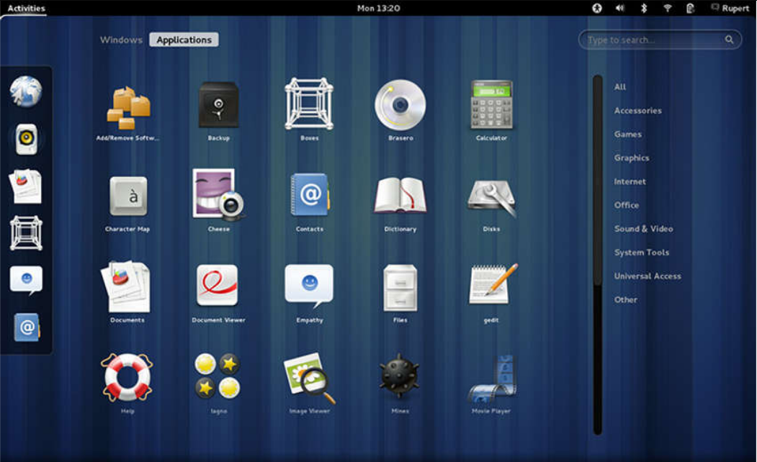
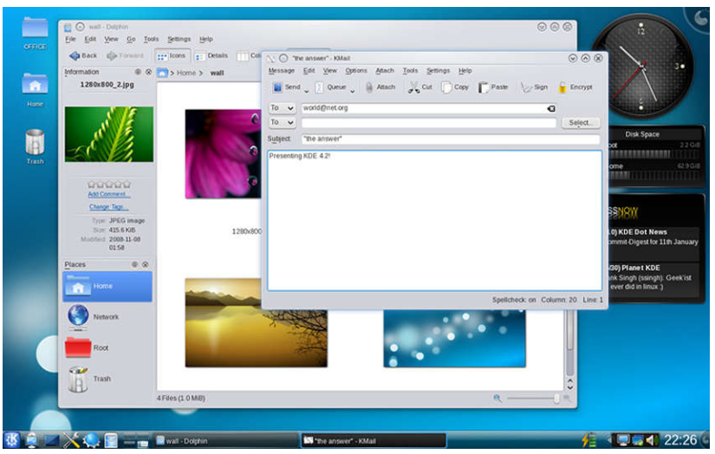
Working with the Linux GUI X Window System (Contd.)
Examples of window managers are Gnome and KDE.
The Gnome Window Manager
The KDE Window Manager
Notes:
4 – Linux Overview
4.6 – Working with the Linux GUI
4.6.1 – X Window System

Slide 65
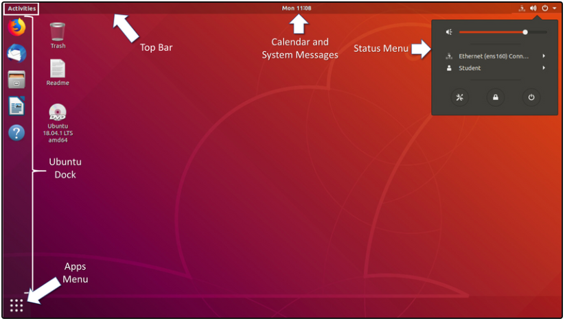
Working with the Linux GUI The Linux GUI
While an operating system does not require a GUI to function, GUIs are considered more user-friendly than the CLI. The Linux GUI as a whole can be easily replaced by the user.
Ubuntu is a very popular and user-friendly Linux distribution.
Ubuntu Linux uses Gnome 3 as its default GUI.
The figure shows the location of some of the features of the Ubuntu Gnome 3 Desktop.
Notes:
4 – Linux Overview
4.6 – Working with the Linux GUI
4.6.2 – The Linux GUI

Slide 66
Working with the Linux GUI The Linux GUI (Contd.)
The following table lists the main UI components of Unity:
UI Component | Description
Apps Menu | The Apps Menu shows icons for the apps that are installed on the system. A right-click menu provides shortcuts that allow starting or configuring the apps. The system search box is available from Activities View.
Ubuntu Dock | A dock on the left side of the screen that serves as an application launcher and switcher for app favorites. Click to launch an application and when the application is running, click again to switch between running applications. If more than one application is running, launcher will display all instances. Right-click any application on the launcher to see details about that the application.
Top Bar | This menu bar contains a menu for the application that currently has the focus. It displays the current time and indicates whether there are new system messages. It also provides access to the Activity desktop view and the system Status Menu.
Notes:
4 – Linux Overview
4.6 – Working with the Linux GUI
4.6.2 – The Linux GUI

Slide 67
Working with the Linux GUI The Linux GUI (Contd.)
UI Component | Description
Calendar and System Message Tray | Click the day and time to see the full appointment calendar and any current system messages. Access the appointment calendar from here to create new appointments.
Activities | Switch to application view to switch to or close running applications. A powerful search tool is available here that will find apps, files, and values within files. Allows switching between workspaces.
Status Menu | Allows configuration of the network adaptor and other running devices. The current user can logoff or change their settings. System configuration changes can be made here. The workstation can be locked or shutdown from here.
Notes:
4 – Linux Overview
4.6 – Working with the Linux GUI
4.6.2 – The Linux GUI

Slide 68
4.7 Working on a Linux Host
Notes:
Source:
4 – Linux Overview
4.7 – Working on a Linux Host
In-Session Activities / Explanations:
Time: 15 mins
Instructor Notes:
This topic describes the working on a Linux host and discuss installing and running of applications on a Linux host.
Explain the importance of keeping the system up to date.
Discuss about the processes and forks with the learners.
Talk over malware threat on a Linux host and how to perform a check on rootkit malware.
By the end of the topic, ensure the learners know about piping commands.
Key Points: Forks, Linux malware, Rootkit, Pipping Commands

Slide 69
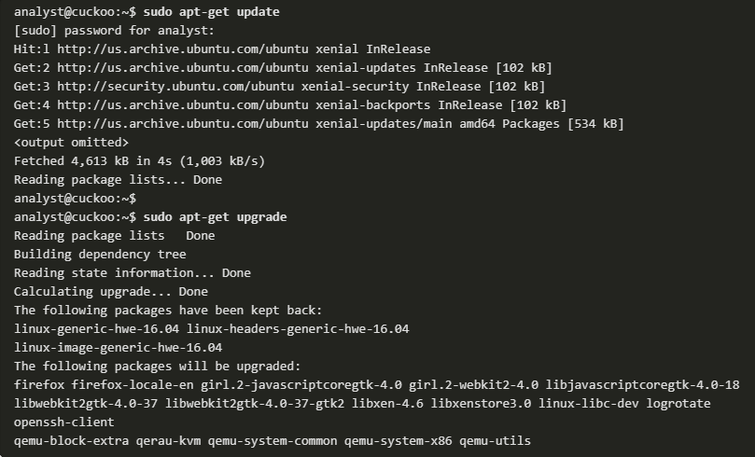
Working on a Linux Host Installing and Running Applications on a Linux Host
Many end-user applications are complex programs written in compiled languages.
To aid in the installation process, Linux includes programs called package managers.
By using a package manager to install a package, all the necessary files are placed in the correct file system location.
A package is the term used to refer to a program and all its supporting files.
The command output shows the output of a few apt-get commands used in Debian distributions.
Notes:
4 – Linux Overview
4.7 – Working on a Linux Host
4.7.1 – Installing and Running Applications on a Linux Host

Slide 70
Working on a Linux Host Keeping the System Up to Date
OS updates, also known as patches, are released periodically by OS companies to address any known vulnerabilities in their operating systems.
Modern operating systems will alert the user when updates are available for download and installation, but the user can check for updates at any time.
The following table compares Arch Linux and Debian/Ubuntu Linux distribution commands to perform package system basic operations.
Task | Arch | Debian/Ubuntu
Install a package by name | pacman -S | apt install
Remove a package by name | pacman -Rs | apt remove
Update a local package | pacman -Syy | apt-get update
Upgrade all currently installed packages | pacman -Syu | apt-get upgrade
Notes:
4 – Linux Overview
4.7 – Working on a Linux Host
4.7.2 – Keeping the System Up to Date

Slide 71
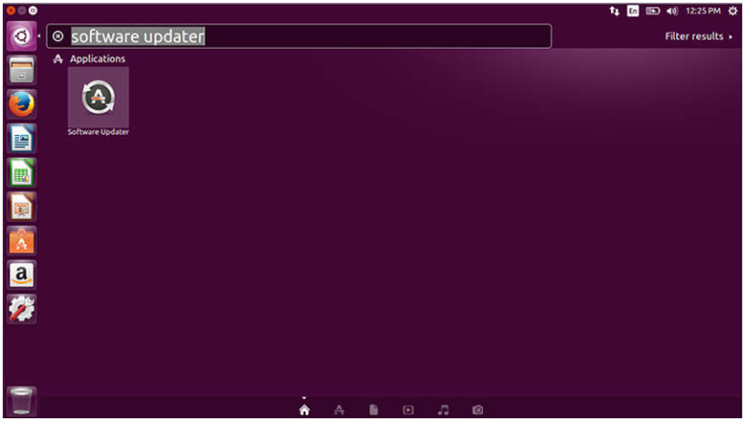
Working on a Linux Host Keeping the System Up to Date (Contd.)
A Linux GUI can also be used to manually check and install updates.
In Ubuntu for example, to install updates you would click Dash Search Box, type software updater, and then click the Software Updater icon.
Notes:
4 – Linux Overview
4.7 – Working on a Linux Host
4.7.2 – Keeping the System Up to Date

Slide 72
Working on a Linux Host Processes and Forks
A process is a running instance of a computer program.
Forking is a method that the kernel uses to allow a process to create a copy of itself.
Processes need a way to create new processes in multitasking operating systems. The fork operation is the only way of doing so in Linux.
When a process calls a fork, the caller process becomes the parent process and the newly created process becomes its child.
After the fork, the processes are, to some extent, independent processes. They have different process IDs but run the same program code.
Notes:
4 – Linux Overview
4.7 – Working on a Linux Host
4.7.3 – Processes and Forks

Slide 73
Working on a Linux Host Processes and Forks (Contd.)
The following table lists three commands that are used to manage processes.
Command | Description
ps | Used to list the processes running on the computer at the time it is invoked. It can be instructed to display running processes that belong to the current user or other users.
top | Used to list running processes, but unlike ps, top keeps displaying running processes dynamically. Press q to exit top.
kill | Used to modify the behavior of a specific process. Depending on the parameters, kill will remove, restart, or pause a process. In many cases, the user will run ps or top before running kill. This is done so the user can learn the PID of a process before running kill.
Notes:
4 – Linux Overview
4.7 – Working on a Linux Host
4.7.3 – Processes and Forks

Slide 74
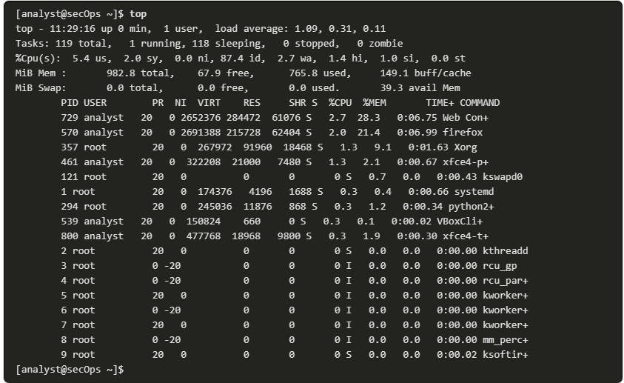
Working on a Linux Host Processes and Forks (Contd.)
The command output shows the output of the top command on a Linux computer.
Notes:
4 – Linux Overview
4.7 – Working on a Linux Host
4.7.3 – Processes and Forks

Slide 75
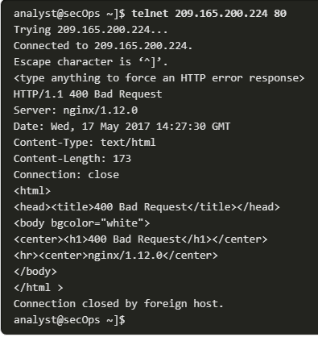
Working on a Linux Host Malware on a Linux Host
Linux malware includes viruses, Trojan horses, worms, and other types of malware that can affect the operating system.
A common Linux attack vector is its services and processes.
The command output shows an attacker using the Telnet command to probe the nature and version of a web server (port 80).
The attacker has learned that the server is running nginx version 1.12.0. The next step would be to research known vulnerabilities in the nginx 1.12.0 code.
Notes:
4 – Linux Overview
4.7 – Working on a Linux Host
4.7.4 – Malware on a Linux Host

Slide 76
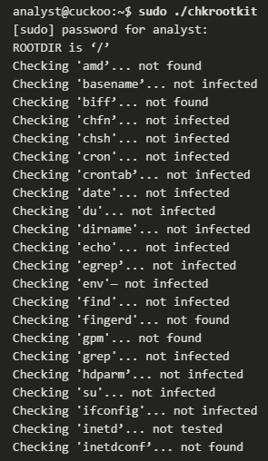
Working on a Linux Host Rootkit Check
A rootkit is a type of malware designed to increase an unauthorized user’s privileges or grant access to portions of the software that should not normally be allowed.
A rootkit is destructive as it changes kernel code and its modules, changing the most fundamental operations of the OS itself.
Rootkit detection methods include booting the computer from a trusted media.
Rootkit removal can be complicated. Re-installation of the operating system is the only real solution to the problem.
chkrootkit is a popular Linux-based program designed to check the computer for known rootkits.
The command output shows the output of chkrootkit on an Ubuntu Linux.
Notes:
4 – Linux Overview
4.7 – Working on a Linux Host
4.7.5 – Rootkit Check

Slide 77
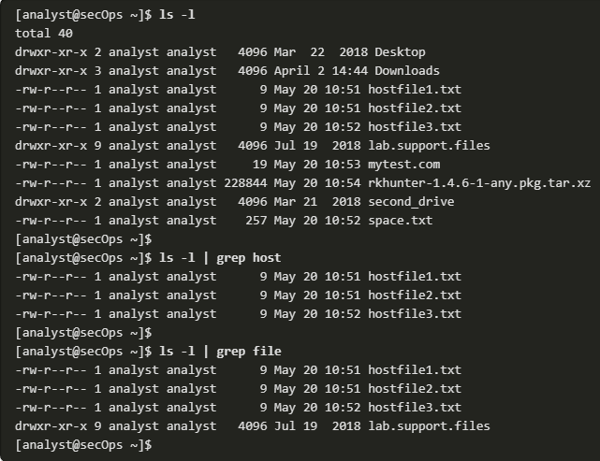
Working on a Linux Host Piping Commands
Although command line tools are usually designed to perform a specific, well-defined task, many commands can be combined to perform more complex tasks by a technique known as piping.
Piping consists of chaining commands together, feeding the output of one command into the input of another.
The two commands, ls and grep, can be piped together to filter out the output of ls. This is shown in the output of the ls -l | grep host command and the ls -l | grep file command.
Notes:
4 – Linux Overview
4.7 – Working on a Linux Host
4.7.6 – Piping Commands

Slide 78
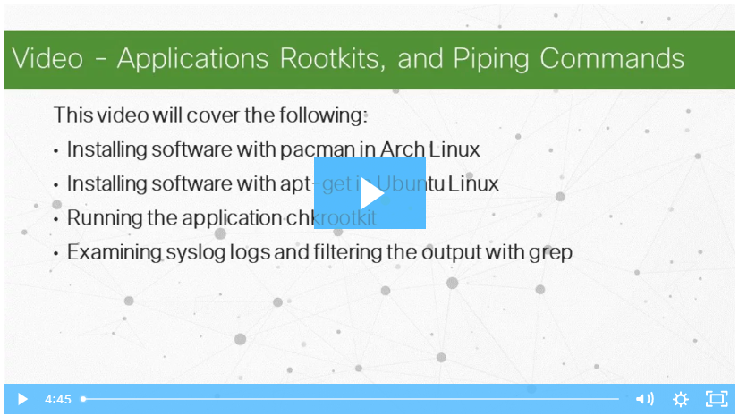
Working on a Linux Host Video Demonstration - Applications, Rootkits, and Piping Commands
Watch the video to view a demonstration of installing and updating applications, checking for a rootkit, and using piping commands.
Notes:
4 – Linux Overview
4.7 – Working on a Linux Host
4.7.7 – Video Demonstration - Applications, Rootkits, and Piping Commands

Slide 79
4.8 Linux Basics Summary
Notes:
Source:
4 – Linux Overview
4.7 – Linux Basics Summary
In-Session Activities / Explanations:
Time: 15 mins
Instructor Notes:
Summarize the module and check if they have any doubts.
Ask them to complete the module quiz present in section 4.8.2.
Key Points: Linux Basics, Linux File System, Linux GUI, Linux Host

Slide 80
Linux Basics Summary What Did I Learn in this Module?
Linux is a fast, reliable, and small open-source operating system.
In Linux, the user communicates with the operating system through a GUI or a command-line interface (CLI), or shell.
Servers are computers that have software installed that enables them to provide services to client computers across the network.
In Linux, servers are managed by using configuration files. Various settings can be modified and saved in configuration files.
Linux supports a number of different file systems that vary by speed, flexibility, security, size, structure, logic, and more. Some of the file systems that are supported by Linux are ext2, ext3, ext4, NFS, and CDFS.
The X Windows, or X11, system is a basic software framework that includes functions for creating, controlling, and configuring a windows GUI in a point-and-click interface.
To install applications on Linux hosts, programs called package managers are used. Packages are software applications and all of their supporting files.
Notes:
4 – Linux Overview
4.8 – Linux Basics Summary
4.8.1 – What Did I Learn in this Module?
4.8.2 – Module 4: Linux Basics Quiz

Slide 81
Module 4 New Terms and Commands
Security Operations Center (SOC) Security information and event management (SIEM) Intrusion detection systems (IDSs) PenTesting Symlink, Hard link | ps, top, kill Is, grep Forking ext2, ext3, ext4 NFS (Network File System) Intrusion detection systems (IDSs)
Notes:
4 – Linux Overview
New Terms and Commands

